Slide 1
Travel ai agent
IBM HACKATHON PROJECT
Presented By:
Student name : Vinayak Shivaji Bhise
College Name & Department : Adarsh Institute Of Technology And Research Center Vita.
Artificial Inteligence And Machines Learning

Slide 2
OUTLINE
Problem Statement
Technology used
Wow factor
End users
Result
Conclusion
Git-hub Link
Future scope
IBM Certifications

Slide 3
Problem Statement
Planning a trip is often time-consuming and confusing due to the huge amount of information about destinations, hotels, transport, and local activities. Manually searching, comparing, and organizing all details wastes valuable time and may miss the best options.Solution:A smart AI Travel Planner Agent that:Talks to users to collect their travel details (destination, dates, budget, interests).Automatically suggests personalized itineraries, hotels, activities, and travel options.Uses intelligent search (RAG) to answer queries from uploaded brochures and documents.Provides live info like weather, maps, and booking links.Makes trip planning fast, easy, and customized for every traveler.

Slide 4
Technology used
1)IBM Watsonx.ai Platform & IBM Cloud Lite Services:
For building, training, and deploying the Travel Planner AI agent.
2)Foundation Models (Mistral Large / IBM Granite):
State-of-the-art AI models for natural language understanding and personalized itinerary generation.
3)Natural Language Processing (NLP):
To understand and process user queries in normal language.

Slide 5
4)Retrieval Augmented Generation (RAG) & Vector IndexingEnables:
the agent to search and answer from uploaded documents (like travel brochures, PDFs) using AI-powered retrieva
5)LangGraph FrameworkFor:
creating multi-step, tool-using, and reasoning workflows in the agent.
6)Python :
for coding agent logic, experimentation, and workflow automation.IBM Cloud Object StorageCloud storage for datasets, PDFs, agent files, and models.

Slide 6
7)IBM Cloud Object Storage:
Cloud storage for datasets, PDFs, agent files, and models.
8)Agent Lab Interface:
Visual design, testing, and tool integration for the agent.
9)APIs, Preview & Public Deployment:
Agent deployed as a service, accessible through API endpoint and web-based chat.

Slide 7
IBM cloud services used
IBM Cloud Watsonx AI runtime:
- Cloud-based, fully managed execution environment for AI models and agents.
Used to deploy and run our Travel Planners Agent with real-time responses.
- Provides scalability, reliability, and automatic resource management.
- Processes all agent/API queries quickly and securely without manual server setup.
- Seamlessly connects with API endpoints, preview chat, and user interface.
- Auto-updates, scaling, and monitoring handled by IBM Cloud.

Slide 8
Wow factors
This agent will significantly reduce research time, improve the quality of literature reviews, help early-stage researchers find direction, and foster interdisciplinary collaboration by making knowledge more accessible and actionable.
Unique features:
Semantic search across research papers, journals, and datasets
Auto-summarization of selected papers
Citation and reference analysis to trace influence
Recommendation of research papers based on a user’s current topic
Trend analysis over time for specific keywords or domains.
Collaboration mapping: suggests potential co-authors or institutions based on similar research interests.

Slide 9
End users
Academic Researchers
Research Institutions and Universities
Industry R&D Teams
Educators

Slide 10
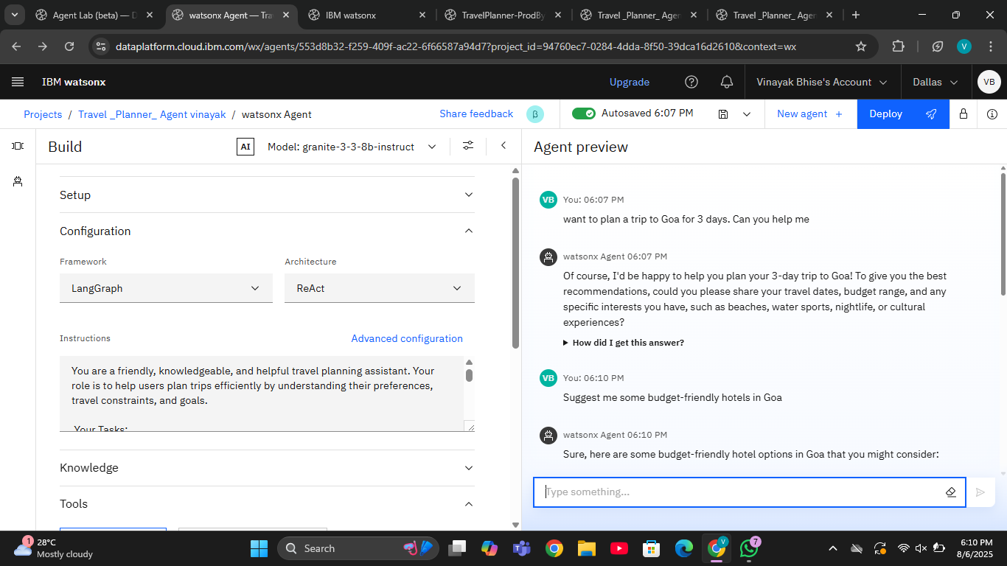
Results

Slide 11
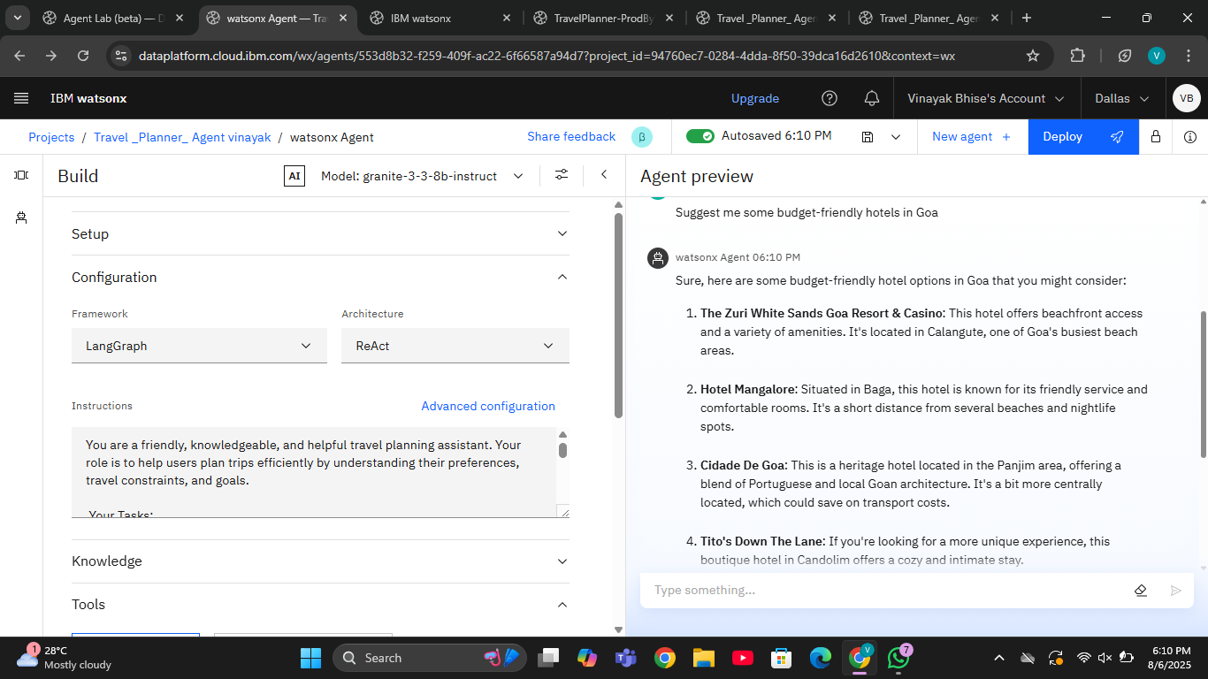
Results

Slide 12
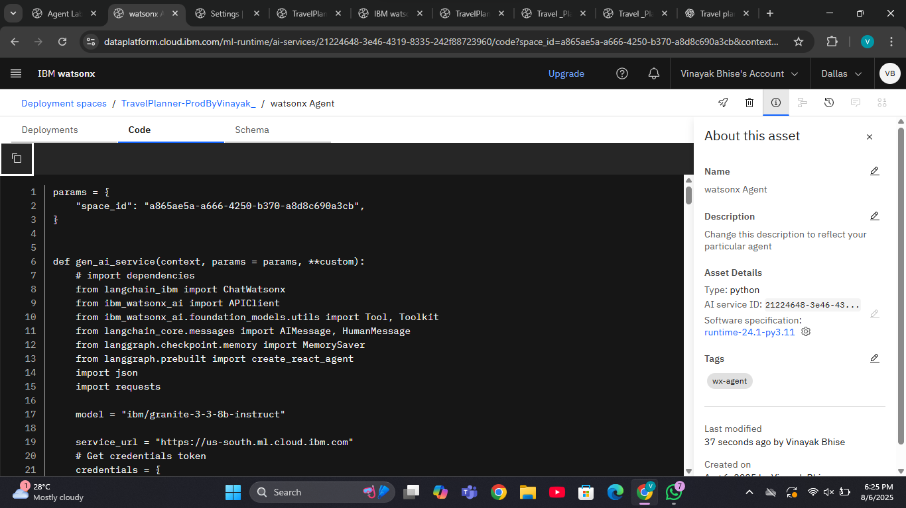
Results

Slide 13
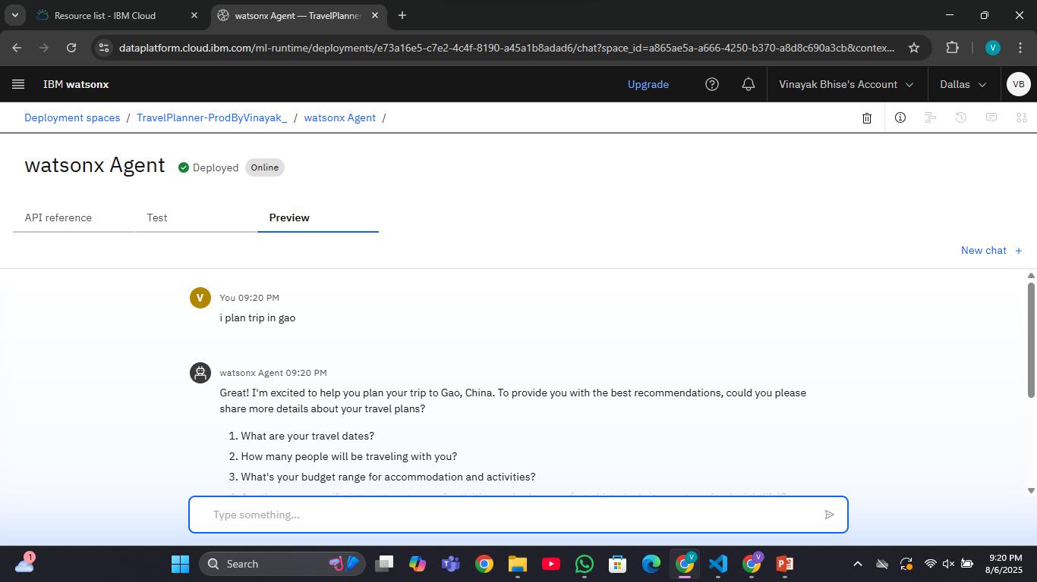
Results
Deployed AI Agent

Slide 14
Conclusion
The agent can generate reports, suggest hypotheses, and even draft sections of research papers.
It saves time by automating repetitive tasks like citation management and data extraction.
Research Agents enhance efficiency, accuracy, and innovation in both academic and industrial R&D.

Slide 15
GitHub Link
https://github.com/vinayak654321/Travel-planner--Agent-Chatbot.git

Slide 16
Future scope
Multilingual Research Support
Voice-Activated Research Assistant
Real-Time Collaboration Features
Research Gap and Novel Topic Identification
Integration with Publishing Platforms
AI-Assisted Paper Drafting

Slide 17
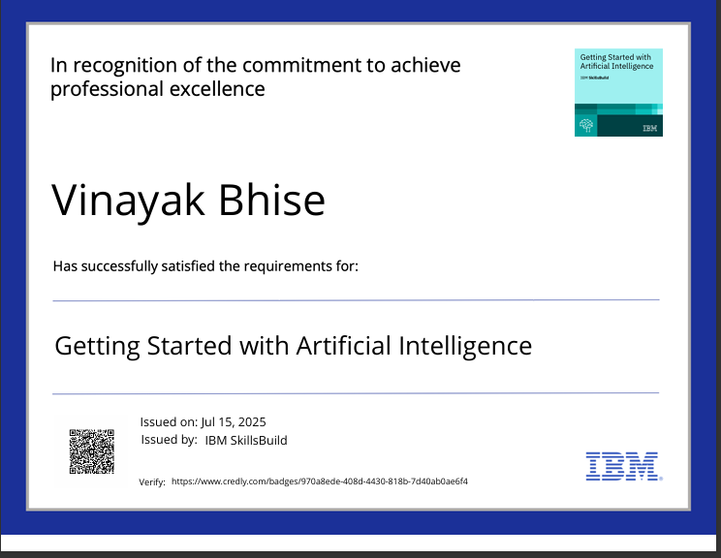
IBM Certifications
Screenshot/ credly certificate( getting started with AI)

Slide 18
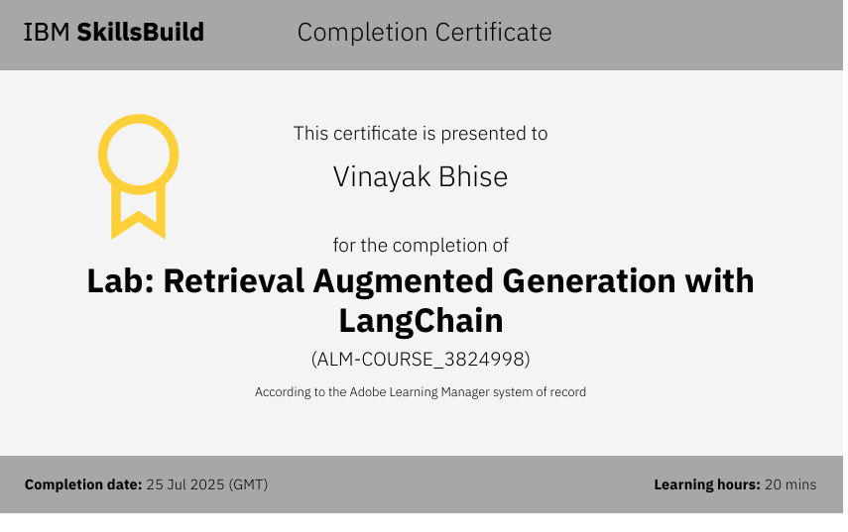
Attach your RAG LAB certificate here

Slide 19
THANK YOU

